Slide 1
Computer-Controlled Manufacturing Machines (ME30204)
PROF. (DR.) DILIP KUMAR PRATIHAR
MECHANICAL ENGINEERING DEPARTMENT, IIT KHARAGPUR

Slide 2
Books
Textbook
Fundamentals of Robotics by D.K. Pratihar
Reference Books
Robotics by Fu, Gonzalez and Lee
Introduction to Robotics by Craig

Slide 3
Topic 1: Introduction to Robots and Robotics

Slide 4
Introduction to Robots and Robotics
A Few Questions
What is a robot?
What is robotics?
Why do we study robotics?
How can we teach a robot to perform a particular task?
What are possible applications of robots?
Can a human being be replaced by a robot?,
and so on.

Slide 5
Definitions
The term: robot has come from the Czech word: robota, which means forced or slave laborer
In 1921, Karel Capek, a Czech playwright, used the term: robot first in his drama named Rossum’s Universal Robots (R.U.R)
According to Karel Capek, a robot is a machine look-wise similar to a human being

Slide 6
Robot has been defined in various ways:
According to Oxford English Dictionary A machine capable of carrying out a complex series of actions automatically, especially one programmable by a computer
According to International Organization for Standardization (ISO): An automatically controlled, reprogrammable, multipurpose manipulator programmable in three or more axes, which can be either fixed in place or mobile for use in industrial automation applications

Slide 7
According to Robot Institute of America (RIA) It is a reprogrammable multi-functional manipulator designed to move materials, parts, tools or specialized devices through variable programmed motions for the performance of a variety of tasks
Note: A CNC machine is not a robot

Slide 8
Robotics
It is a science, which deals with the issues related to design, manufacturing, usages of robots
In 1942, the term: robotics was introduced by Isaac Asimov in his story named Runaround
In robotics, we use the fundamentals of Physics, Mathematics, Mechanical Engg., Electronics Engg., Electrical Engg., Computer Sciences, and others

Slide 9
3 Hs in Robotics
3 Hs of human beings are copied into Robotics, such as
Hand
Head
Heart

Slide 10
Motivation
To cope with increasing demands of a dynamic and competitive market, modern manufacturing methods should satisfy the following requirements:
Reduced production cost
Increased productivity
Improved product quality
Notes:
(1) Automation can help to fulfil the above requirements
(2) Automation: Either Hard or flexible automation
(3) Robotics is an example of flexible automation

Slide 11
A Brief History of Robotics
Year | Events and Development
1954 | First patent on manipulator by George Devol, the father of robot
1956 | Joseph Engelberger started the first robotics company: Unimation
1962 | General Motors used the manipulator: Unimate in die-casting application

Slide 12
Year | Events and Development
1967 | General Electric Corporation made a 4-legged vehicle
1969 | SAM was built by the NASA, USA Shakey, an intelligent mobile robot, was built by Stanford Research Institute (SRI)
1970 | Victor Scheinman demonstrated a manipulator known as Stanford Arm Lunokhod I was built and sent to the moon by USSR ODEX 1 was built by Odetics

Slide 13
Year | Events and Development
1973 | Richard Hohn of Cincinnati Milacron Corporation manufactured T³ (The Tomorrow Tool) robot
1975 | Raibart at CMU, USA, built a one-legged hopping machine, the first dynamically stable machine
1978 | Unimation developed PUMA (Programmable Universal Machine for Assembly)

Slide 14
Year | Events and Development
1983 | Odetics introduced a unique experimental six-legged device
1986 | ASV (Adaptive Suspension Vehicle) was developed at Ohio State University, USA
1997 | Pathfinder and Sojourner was sent to the Mars by the NASA, USA

Slide 15
Year | Events and Development
2000 | Asimo humanoid robot was developed by Honda
2004 | The surface of the Mars was explored by Spirit and Opportunity
2012 | Curiosity was sent to the Mars by the NASA, USA
2015 | Sophia (humanoid) was built by Hanson Robotics, Hong Kong

Slide 16
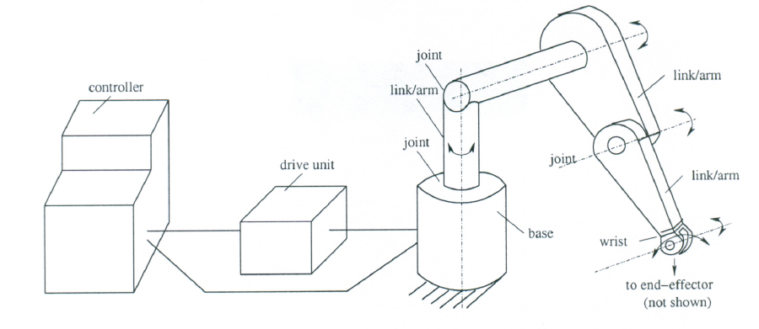
A Robotic System
Various Components
Base
Links and Joints
End-effector / gripper
Wrist
Drive / Actuator
Controller
Sensors

Slide 17
Interdisciplinary Areas in Robotics
Mechanical Engineering
Kinematics: Motion of robot arm without considering the
forces and /or moments
Dynamics: Study of the forces and/or moments
Sensing: Collecting information of the environment

Slide 18
Interdisciplinary Areas in Robotics (Cont.)
Computer Science
Motion Planning: Planning the course of action
Artificial Intelligence: To design and develop suitable brain for the robots
Electrical and Electronics Engg.
Control schemes and hardware implementations
General Sciences
Physics
Mathematics

Slide 19
Connectivity / Degrees of Freedom of a Joint
It indicates the number of rigid (bodies) that can be connected to a fixed rigid body through the said joint
Joints with One dof
Revolute Joint (R)

Slide 20
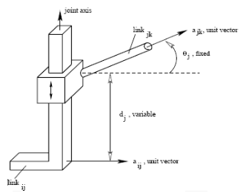
Joints with One dof
Prismatic Joint (P)

Slide 21
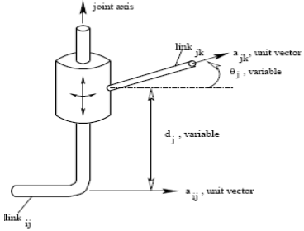
Joints with two dof
Cylindrical Joint (C)

Slide 22
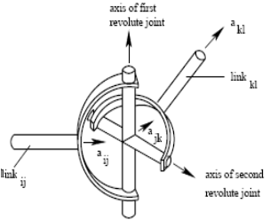
Joints with two dof
Hooke Joint or Universal Joint (U)

Slide 23
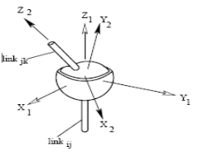
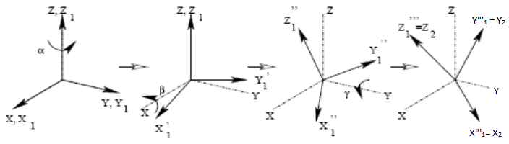

Joints with three dof
Ball and Socket Joint / Spherical Joint $(S′)$

Slide 24


Representation of the Joints
Revolute joint (R)
Prismatic joint (P)
Cylindrical joint (C)

Slide 25



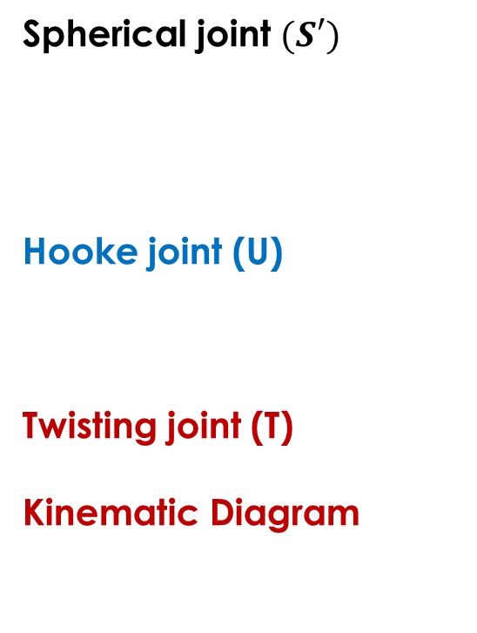
Representation of the Joints
Spherical joint $(S′)$
Hooke joint (U)
Twisting joint (T)
Kinematic Diagram

Slide 26
Degrees of Freedom of a System
It is defined as the minimum number of independent parameters / variables / coordinates needed to describe a system completely
Notes
A point in 2-D: 2 dof; in 3-D space: 3 dof
A rigid body in 3-D: 6 dof
Spatial Manipulator: 6 dof
Planar Manipulator: 3 dof

Slide 27
Redundant Manipulator
Either a Spatial Manipulator with more than 6 dof
or a Planar Manipulator with more than 3 dof
Under-actuated Manipulator
Either a Spatial Manipulator with less than 6 dof
or a Planar Manipulator with less than 3 dof

Slide 28
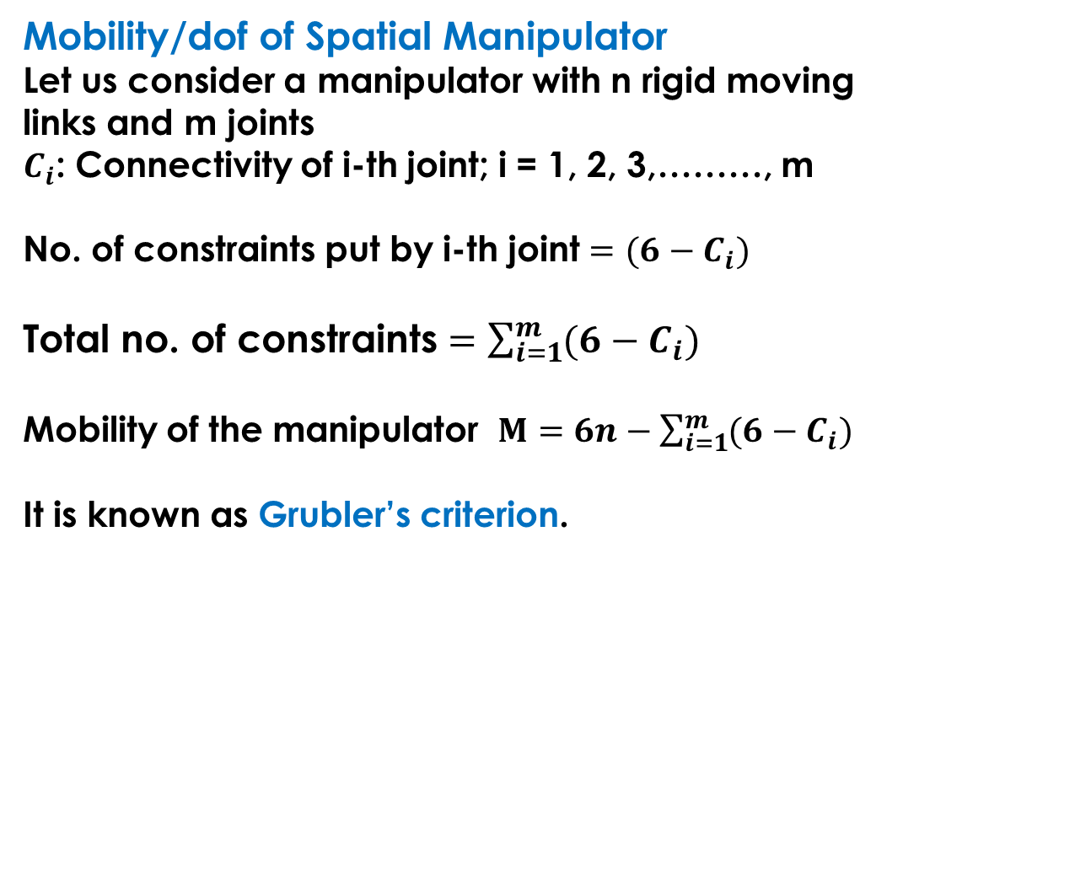
Mobility/dof of Spatial Manipulator
Let us consider a manipulator with n rigid moving
links and m joints
$C_{i}$: Connectivity of i-th joint; i = 1, 2, 3,………, m
No. of constraints put by i-th joint $=(6−C_{i})$
Total no. of constraints $=\sum_{i=1}^{m}{(6−C_{i})}$
Mobility of the manipulator $M=6n−\sum_{i=1}^{m}{(6−C_{i})}$
It is known as Grubler’s criterion.

Slide 29
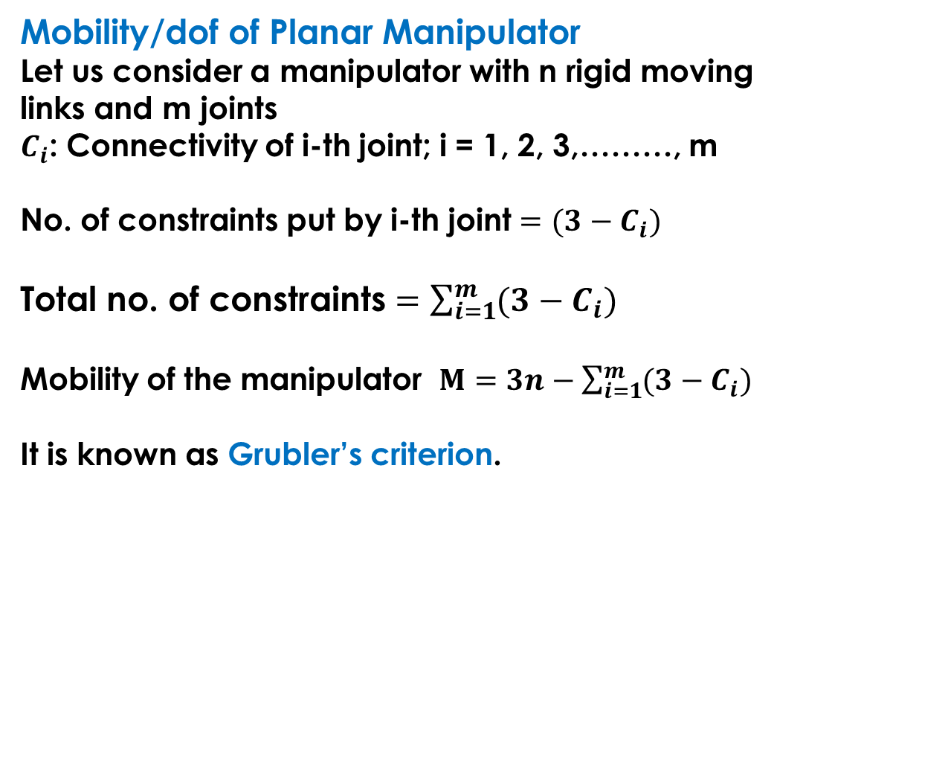
Mobility/dof of Planar Manipulator
Let us consider a manipulator with n rigid moving
links and m joints
$C_{i}$: Connectivity of i-th joint; i = 1, 2, 3,………, m
No. of constraints put by i-th joint $=(3−C_{i})$
Total no. of constraints $=\sum_{i=1}^{m}{(3−C_{i})}$
Mobility of the manipulator $M=3n−\sum_{i=1}^{m}{(3−C_{i})}$
It is known as Grubler’s criterion.

Slide 30
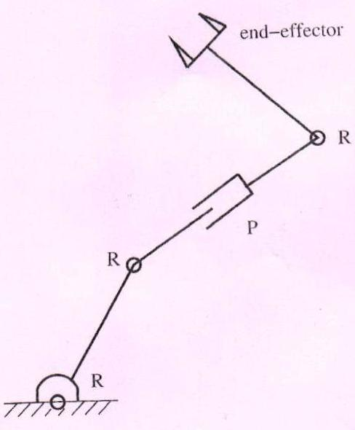

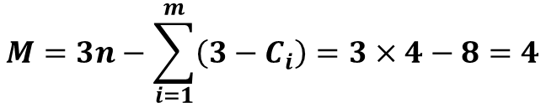


Numerical Example
Serial planar manipulator
$$n=4,$$
$$m=4$$
$$C_{1}=C_{2}=C_{3}=C_{4}=1$$
Mobility/dof:
$$M=3n−\sum_{i=1}^{m}{\left(3−C_{i}\right)=3×4−8=4}$$

Slide 31
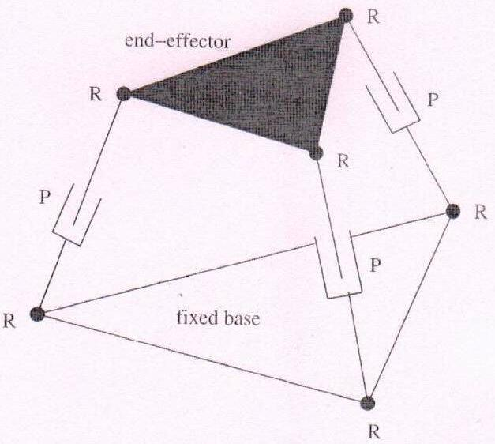

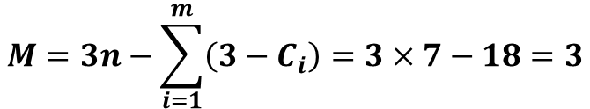

Parallel planar manipulator
$$n=7,$$
$$m=9$$
$$C_{i}=1, where i=1,…,9$$
Mobility/dof:
$$M=3n−\sum_{i=1}^{m}{\left(3−C_{i}\right)=3×7−18=3}$$

Slide 32
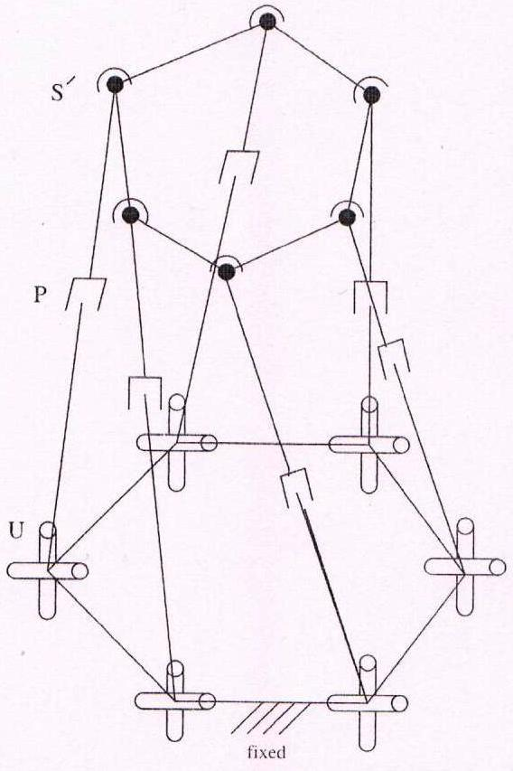


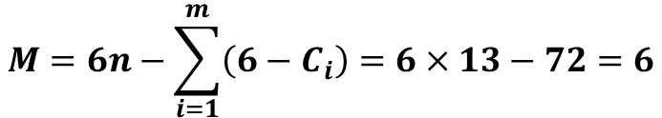
Parallel spatial manipulator
$$n=13,$$
$$m=18$$
Mobility/dof:
$$M=6n−\sum_{i=1}^{m}{\left(6−C_{i}\right)=6×13−72=6}$$

Slide 33
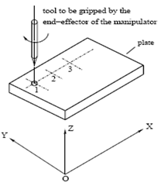
Classification of Robots
Based on the Type of Tasks Performed
Point-to-Point Robots
Examples:
Unimate 2000
T³

Slide 34
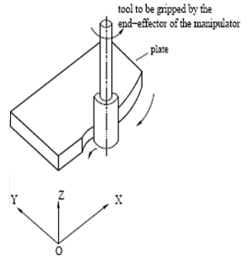
Continuous Path Robots
Examples:
PUMA
CRS

Slide 35
Based on the Type of Controllers
Non-Servo-Controlled Robots
Open-loop control system
Examples: Seiko PN-100
Less accurate and less expensive
Servo-Controlled Robots
Closed-loop control system
Examples: Unimate 2000, PUMA,
T³
More accurate and more expensive

Slide 36
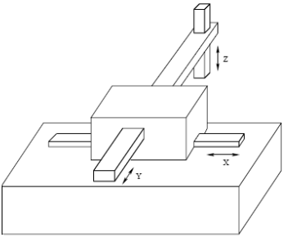
Based on Configuration (coordinate system) of the Robot
Cartesian Coordinate Robots
Linear movement along three different axes
Have either sliding or prismatic joints, that is, SSS or PPP
Rigid and accurate
Suitable for pick and place type of operations
Examples: IBM’s RS-1, Sigma robot

Slide 37

Cylindrical Coordinate Robots
Two linear and one rotary movements
Represented as TPP, TSS
Used to handle parts/ objects in manufacturing
Cannot reach the objects lying on the floor
Poor dynamic performance
Examples: Versatran 600

Slide 38
Spherical Coordinate or Polar Coordinate Robots
One linear and two rotary movement
Represented as TRP, TRS
Suitable for handling parts/objects in manufacturing
Can pick up objects lying on the floor
Poor dynamic performance
Examples: Unimate 2000B

Slide 39
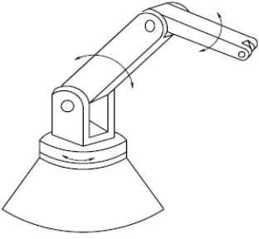
Revolute Coordinate or Articulated Coordinate Robots
Rotary movement about three independent axes
Represented as TRR
Suitable for handling parts/components in manufacturing system
Rigidity and accuracy may not be good enough
Examples: T3, PUMA

Slide 40
Based on Mobility Levels
Robots with fixed base (also known as manipulators)
Serial Parallel
PUMA, CRS Stewart platform
Manipulators

Slide 41
Based on Mobility Levels (contd.)
Mobile robots
Wheeled robots Tracked robots Multi-legged robots
Mobile robots

Slide 42
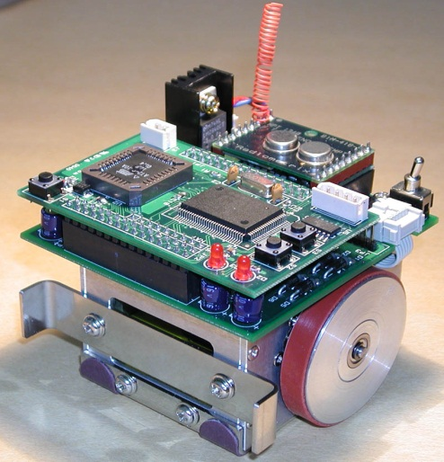
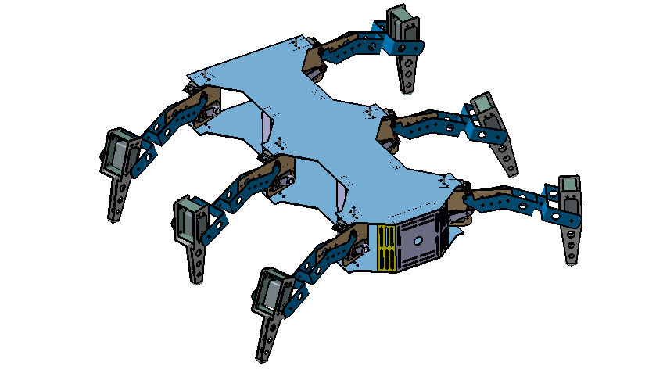
Based on Mobility Levels (contd.)
Mobile robots
Wheeled Robot Six-legged Robot

Slide 43
Workspace of Manipulators
It is the volume of space that the end-effector of a manipulator can reach
Dextrous Reachable
Workspace

Slide 44
Dextrous Workspace
It is the volume of space, which the robot’s end-effector can reach with various orientations
Reachable Workspace
It is the volume of space that the end-effector can reach with one orientation
Note
Dextrous workspace is a subset of the
reachable workspace

Slide 45
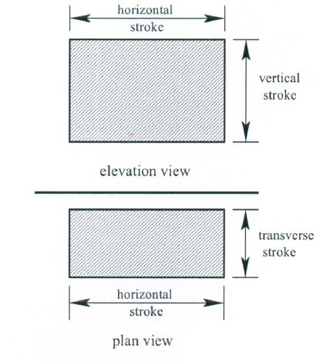
Workspace of Cartesian Coordinate Robot

Slide 46
Workspace of Cylindrical Coordinate Robot

Slide 47
Workspace of Spherical Coordinate Robot

Slide 48
Workspace of Revolute Coordinate Robot

Slide 49
Resolution, Accuracy and Repeatability
Resolution
It is defined as the smallest allowable position increment of a robot
Resolution
Programming resolution
Smallest allowable position increment in robot programme
Basic Resolution Unit
BRU = 0.01 inch/0.1degree
Control resolution
Smallest change in position that the feedback device can measure say 0.36 degrees per pulse

Slide 50
Accuracy (mm)
It is the precision with which a computed point can be reached
Repeatability (mm)
It is defined as the precision with which a robot re-position itself to a previous taught point

Slide 51
Applications of Robots
In Manufacturing Units
Advantages of Robots
Robots can work in hazardous and dirty environment
Can increase productivity after maintaining improved quality
Direct labour cost will be reduced
Material cost will be reduced
Repetitive tasks can be handled more efficiently

Slide 52
Application Areas
Arc Welding
Spot Welding
Spray Painting
Pick and Place Operation
Grinding
Drilling
Milling

Slide 53
Under-Water Applications
Purposes
To explore various resources
To study under-water environment
To carry out drilling, pipe-line survey, inspection and repair of ships

Slide 54
Notes
Robots are developed in the form of ROV (Remotely Operated Vehicle) and AUV (Autonomous Under-water Vehicle)
Robots are equipped with navigational sensors, propellers/ thrusters, on-board softwares, and others
Medical Applications
Telesurgery
Micro-capsule multi-legged robots
Prosthetic devices

Slide 55
Space Applications
For carrying out on-orbit services, assembly job and interplanetary missions
Spacecraft deployment and retrieval, survey of outside space shuttle; assembly, testing, maintenance of space stations; transport of astronauts to various locations
Robo-nauts
Free-flying robots
Planetary exploration rovers

Slide 56
In Agriculture
For spraying pesticides
For spraying fertilizers in liquid form
Cleaning weeds
Sowing seeds
Inspection of plants

Slide 57
Some Other Applications
Replacement of maid-servant
Garbage collection
Underground Coal mining
Sewage-line cleaning
Fire-fighting etc.

Slide 58
Robot End-Effectors
An end-effector is a device attached to the wrist of a manipulator for the purpose of holding materials, parts, tools to perform a specific task
End Effectors
Grippers
End-effectors used to grasp and hold objects
Tools
End-effectors designed to perform some specific tasks
Ex: Spot welding electrode, Spray gun

Slide 59
Classification of Grippers
Single gripper and double gripper
Single gripper: Only one gripping device is mounted on the wrist
Double gripper: Two independent gripping devices are attached to the wrist
Example: Two separate grippers mounted on the wrist for loading and unloading applications

Slide 60
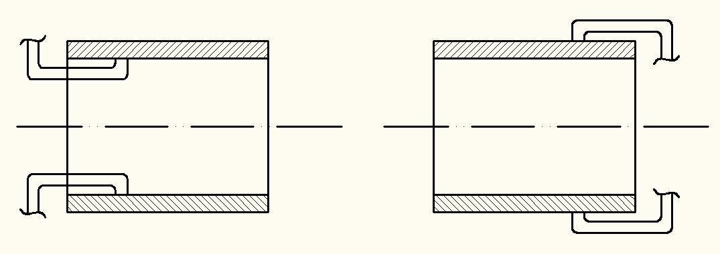
Internal gripper vs. External gripper
Internal gripper External gripper

Slide 61
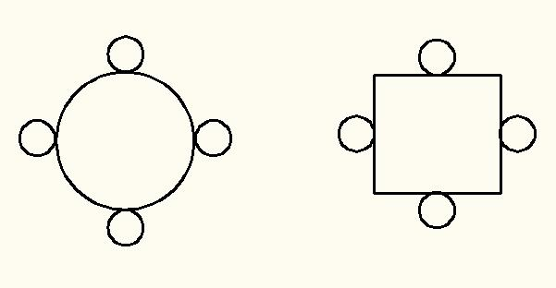
Soft gripper vs. Hard gripper
Hard gripper: Point contact between the finger and object
Soft gripper: Area (surface) contact between the finger and object

Slide 62
4. Active Gripper and Passive Gripper
Active gripper: Gripper equipped with sensor
Passive gripper: Gripper without sensor

Slide 63
A Few Robot Grippers
Mechanical Grippers
Use mechanical fingers (jaws) actuated by some mechanisms
Less versatile, less flexible and less costly

Slide 64
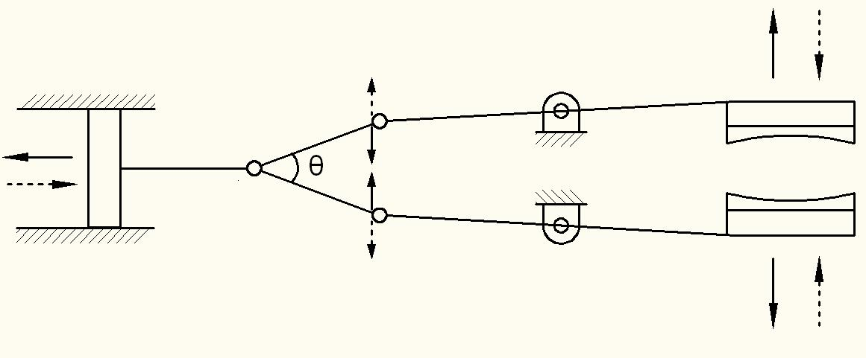
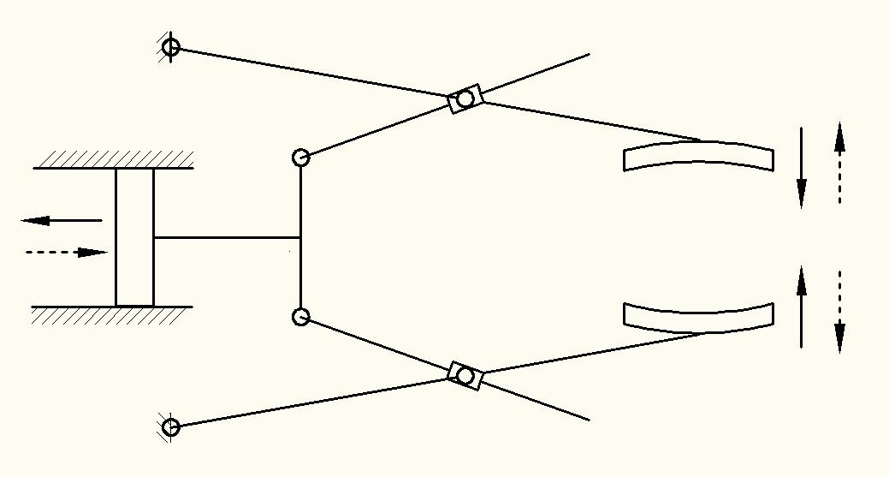
Examples
Gripper with linkage actuation

Slide 65
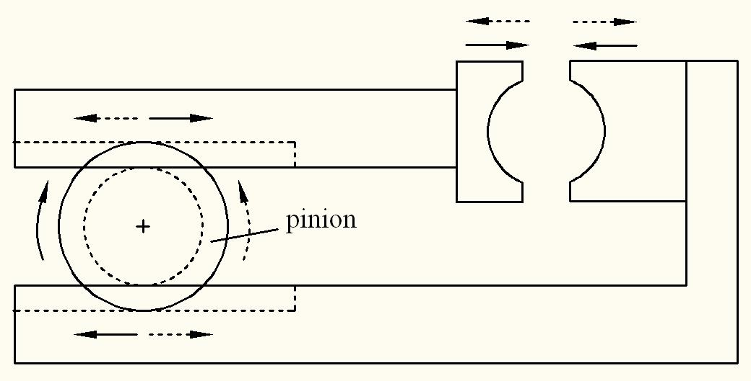
Gripper with rotary actuation

Slide 66
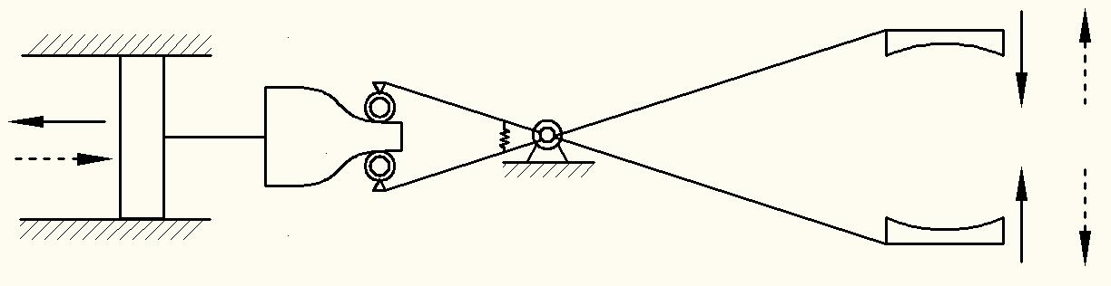
iii. Gripper with cam actuation

Slide 67
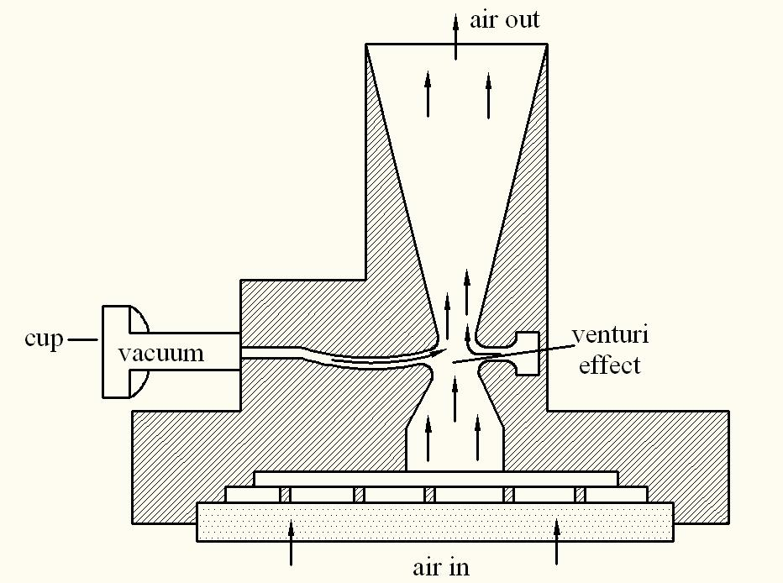
Vacuum Gripper (used for thin parts)

Slide 68
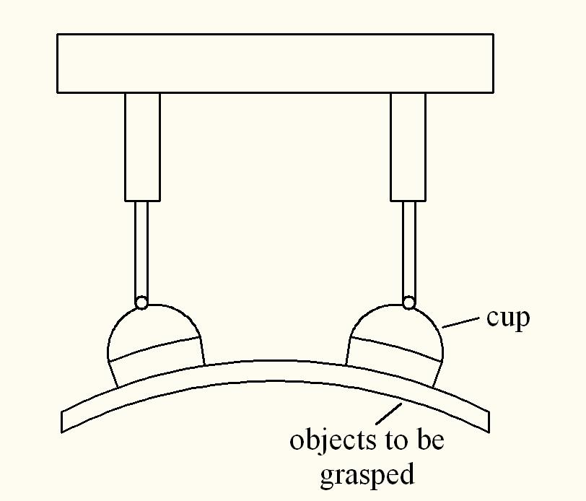
Suction cup is made of elastic material like rubber or soft plastic
When the object to be handled is soft, the cup should be made of hard substance
Two devices can be used: Either Vacuum pump or venturi

Slide 69
Magnetic Gripper (for magnetic materials only. For example: various steels but not stainless steel)
Can use either electro-magnets or permanent magnets
Pick up time is less
Can grip parts of various sizes
Disadvantage: residual magnetism
Stripping device: for separating the part from the permanent magnet
For separating the part from electro-magnet, reverse the polarity

Slide 70
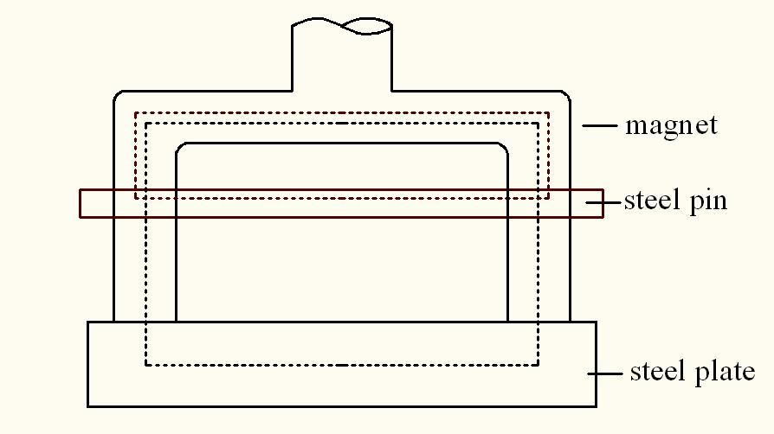
Magnetic Gripper

Slide 71
Adhesive Gripper
Grasping action using adhesive substance
To handle lightweight materials
Universal Gripper
Example: Human gripper

Slide 72
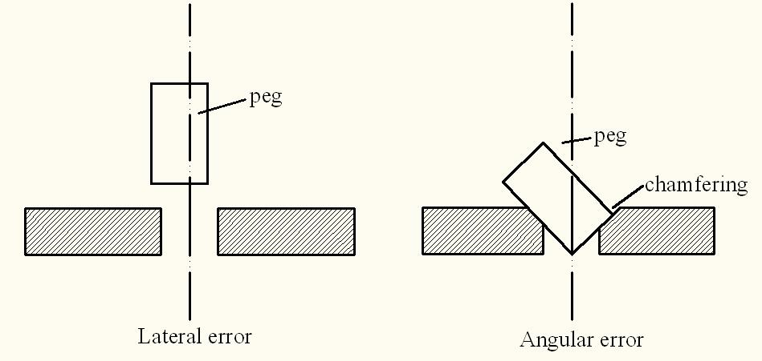
Passive Gripper
Task: To insert a peg into a hole

Slide 73
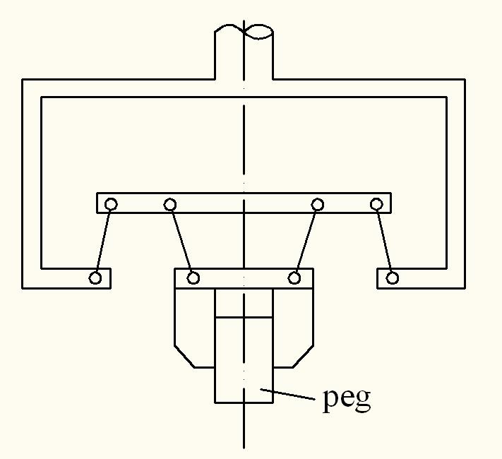
Solution: Use Remote Center Compliance (RCC)
RCC is inappropriate for assembly of pegs in horizontal direction
Insertion angle must be less than 45 degrees
Cannot be used in chamferless insertion tasks

Slide 74
Robot Teaching
To provide necessary instructions to the robot
Online Methods Off-line Methods
(Programming language)
Manual teaching Lead-through Teaching
(point to point task) (continuous path task)
Control handle / Joystick
Push buttons
Teach-pendant
Teaching Methods
Robot simulator

Slide 75
Off-line Method
VAL Programming for PUMA
Task: Pick and place operation
VAL program
APPRO PART, 100
MOVES PART
CLOSEI
DEPARTS 200
APPROS BIN, 300
MOVE BIN
OPENI
DEPART 100
Other VAL commands
SPEED 40
EXECUTE
ABORT
EDIT filename
LISTF
STORE
DELETE
LOAD filename

Slide 76
Specification of a Robot
Control type
Drive system
Coordinate system
Teaching/Programming methods
Accuracy, Repeatability, Resolution
Pay-load capacity
Weight of the manipulator
Applications
Range and speed of arms and wrist
Sensors used
End-effector/ gripper used

Slide 77
Economic Analysis
Let F: Capital investment to purchase a robot which includes its purchasing cost and installation cost
B: Savings in terms of material and labour cost
C: Operating and maintenance cost
D: Depreciation of the robot
A: Net savings
A= B-C-D
G: Tax to be paid on the net savings
Pay-back period, E = (Capital investment, F)/ (B-C-G)

Slide 78
Economic Analysis
Let I: Modified net savings after the payment of tax
Rate of return on investment
H= (I/F)X100%
A company decides to purchase the robot, if
pay-back period < techno-economic life
rate of return on investment > rate of bank interest

Slide 79
Numerical Example
The costs and savings associated with a robot installation are given below.
Costs of a robot including accessories : Rs. 12,00,000
Installation cost : Rs. 3,00,000
Maintenance and operating cost : Rs. 20 per hour
Labour saving : Rs. 100 per hour
Material saving : Rs. 15 per hour
The shop runs 24 hours in a day (in 3 shifts) and the effective workdays in a year are 200. The tax rate of the company is 30% and techno-economic life of the robot is expected to be equal to six years. Determine (a) pay-back period of the robot and (b) rate of return on investment

Slide 80
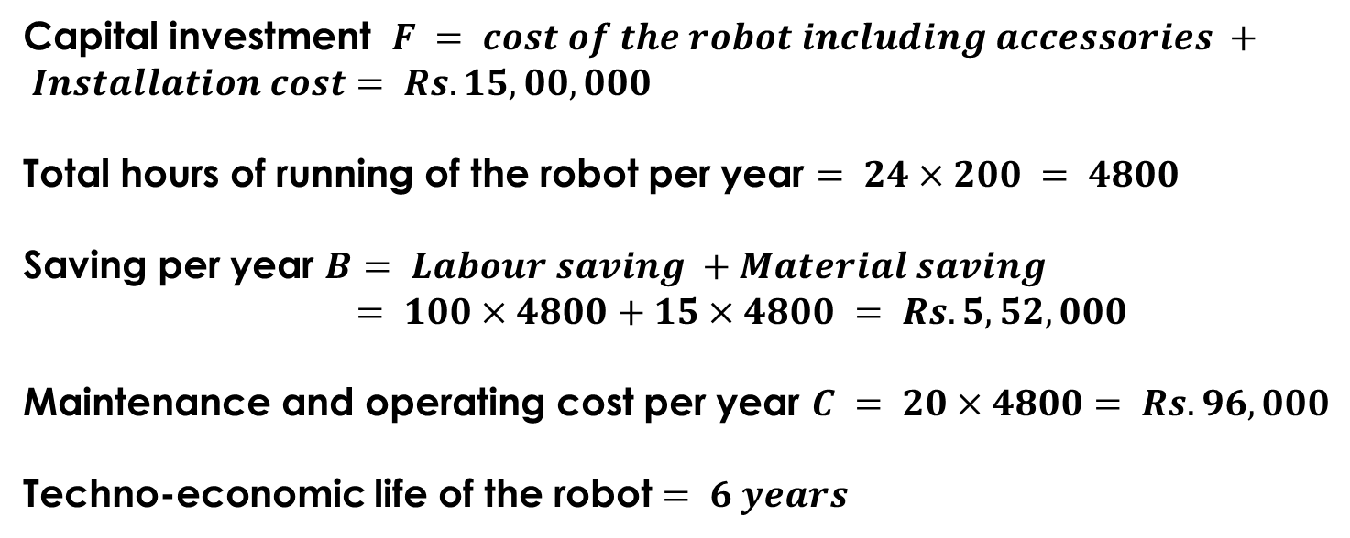
Solution
Capital investment $F = cost of the robot including accessories + Installation cost$ $= Rs. 15,00,000$
Total hours of running of the robot per year $= 24×200 = 4800$
Saving per year $B$ $= Labour saving +Material saving$
$= 100×4800+15×4800 = Rs. 5,52,000$
Maintenance and operating cost per year $C = 20×4800= Rs. 96,000$
Techno-economic life of the robot $= 6 years$

Slide 81
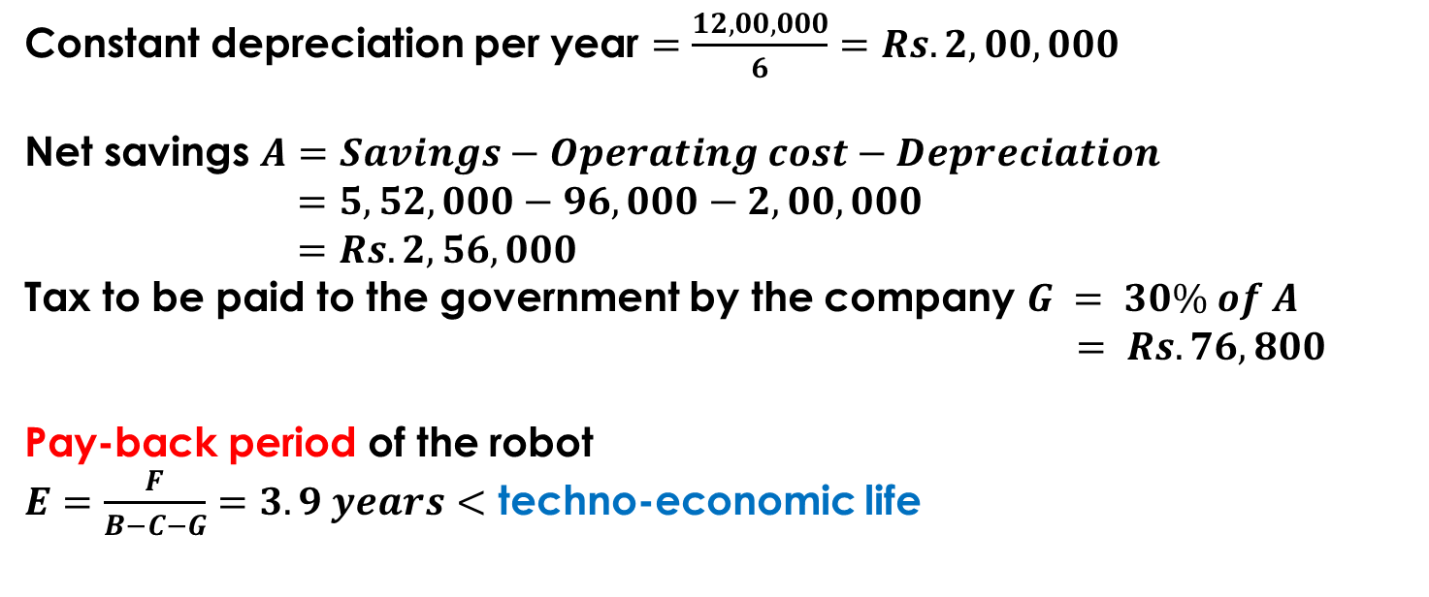
Solution (Cont.)
Constant depreciation per year $=\frac{12,00,000}{6}=Rs. 2,00,000$
Net savings $A=Savings−Operating cost−Depreciation$
$=5,52,000−96,000−2,00,000$
$=Rs. 2,56,000$
Tax to be paid to the government by the company $G = 30\% of A$
$$= Rs. 76,800$$
Pay-back period of the robot
$E=\frac{F}{B−C−G}=3.9 years<$ techno-economic life

Slide 82
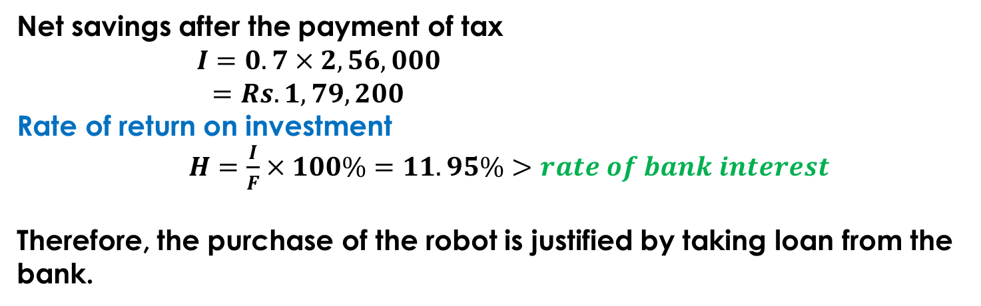
Solution (Cont.)
Net savings after the payment of tax
$I=0.7×2,56,000$
$=Rs. 1,79,200$
Rate of return on investment
$H=\frac{I}{F}×100\%=11.95\%>rate of bank interest$
Therefore, the purchase of the robot is justified by taking loan from the bank.

